Slide 1
Member-driven & cloud-vetted cloud financial management
Notes:
FinOps is Kaizen continuous improvement - OSS a key part
Last week, FinOps Foundation members voted to become a program of the Linux Foundation (LF)! This move is not finalized (or announced yet) so please avoid social media or sharing outside this group.
Many asked for more information about what this change will mean for the FinOps Foundation. Attend this meeting to hear details and ask questions of the Linux Foundation team, including Chris Aniszczyk, CTO of the Cloud Native Computing Foundation.
The LF will enable FinOps to scale our mission to advance the people and best practices of cloud financial management while the LF takes over our back office operations. It will also give us access to a big support team and a vibrant open source community that includes Cloud Native Computing Foundation, Kubernetes, and more.

Slide 2
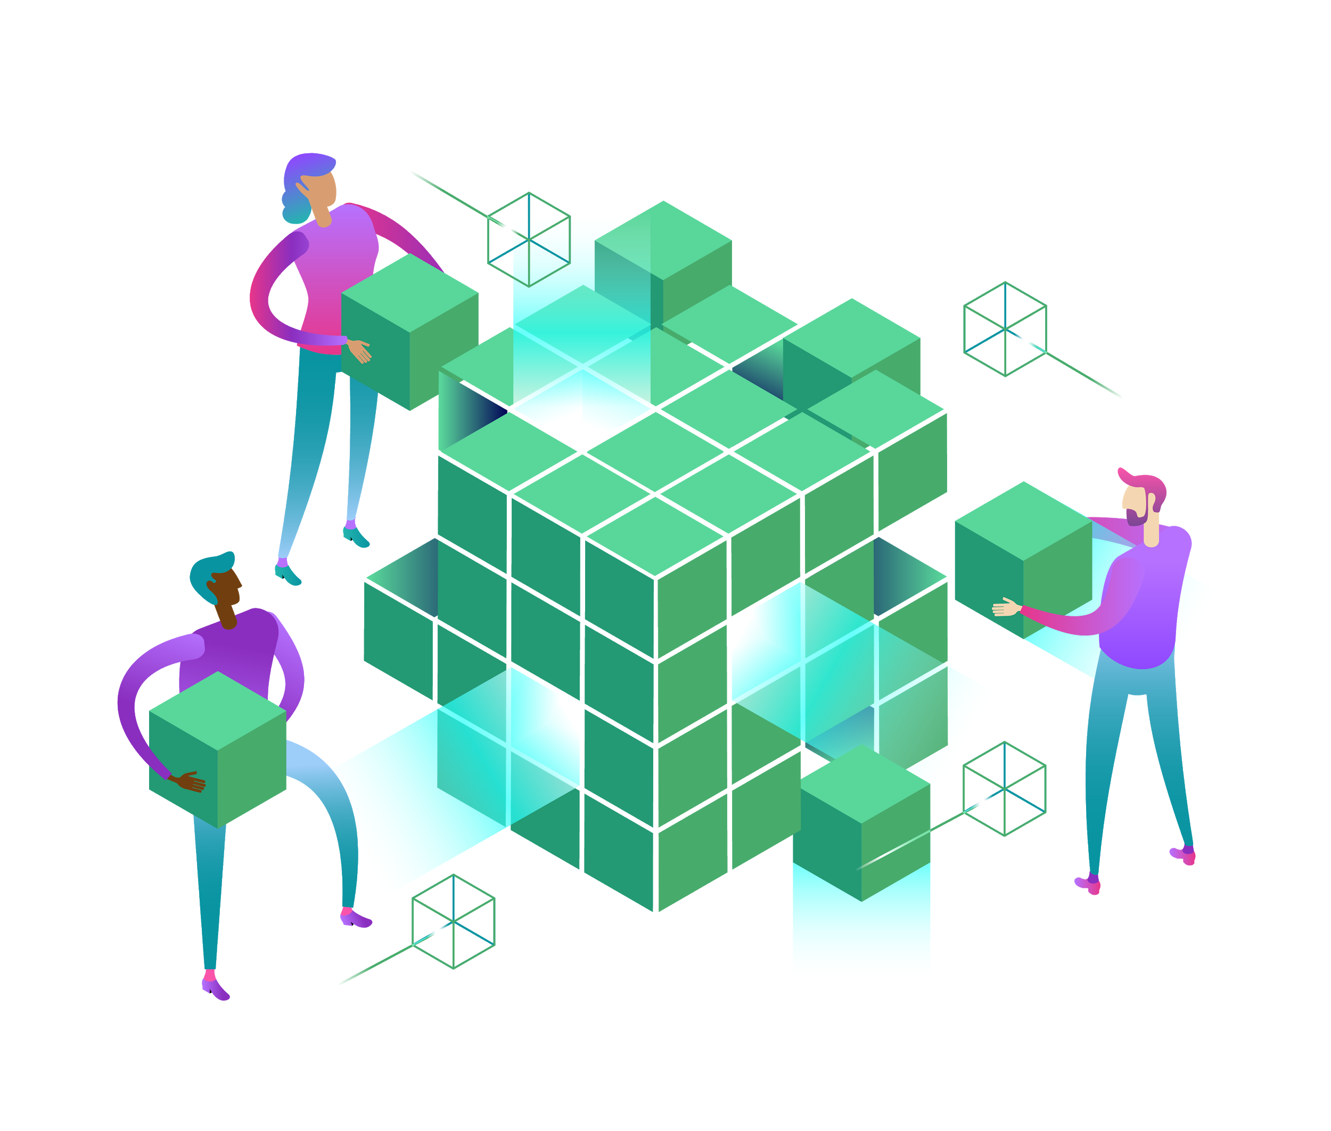
Mission of the FinOps Foundation (F2)
Central community for cloud financial management (regardless of cloud or vendor)
Advance careers of FinOps practitioners (through career development, educational and certification programs)
Define cloud financial management standards (make them ubiquitous through open source)
Non-profit trade association that launched with ~30 founding members, now made up of over 1300+ industry experts. Including Nationwide, Spotify, Nike, MIT, Atlassian, HERE Technologies, Australia Post, UK Government, Thermo Fisher Scientific, Just Eat, Pearson, Sainsbury's, Middle East Broadcasting Company, Tabcorp, Autodesk, Neustar, etc.

Slide 3
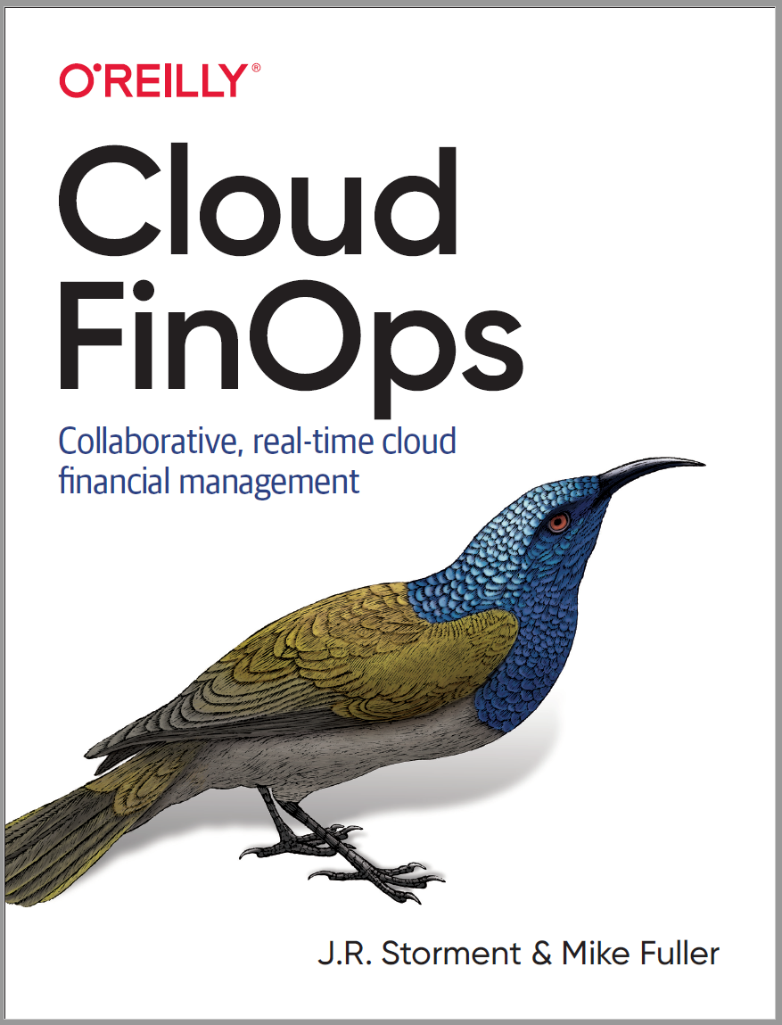
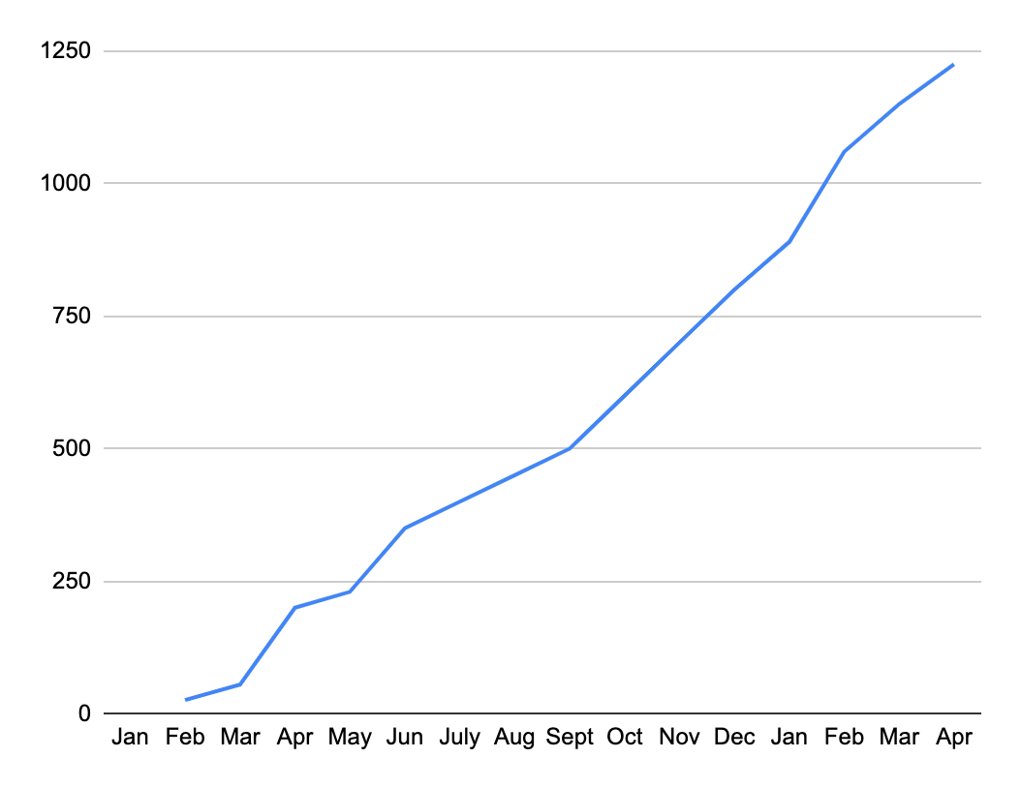
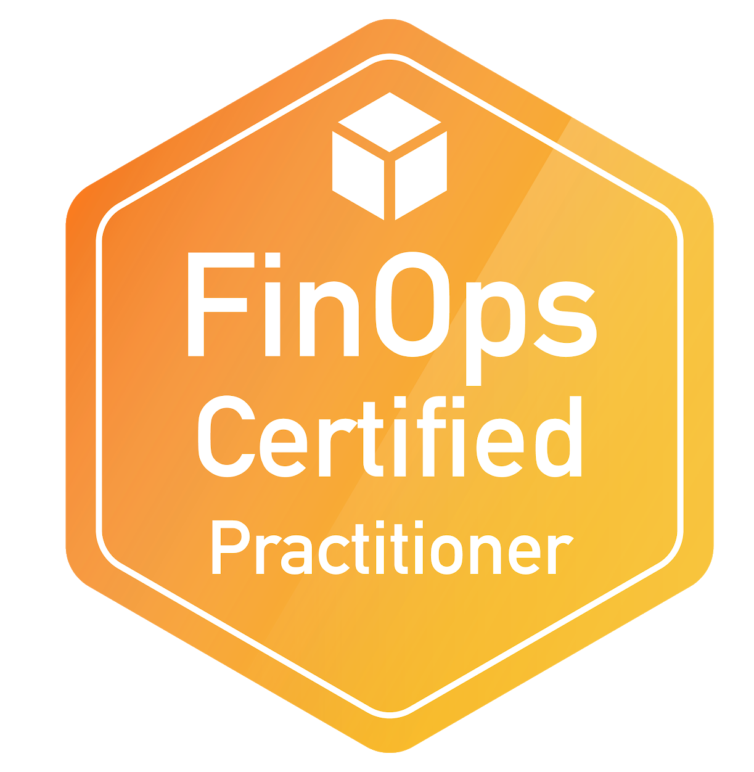
FinOps membership growing fast...
1500+ Total members
550+ Companies over $1bn revenue
175+ Consultancies
700+ active slack members
300+ certifications awarded
250+ members join monthly calls
Amazon.com
F2 Members since Feb 2019

Slide 4
Code of Conduct
As a member I will: contribute and be respectful
Inclusion: Treat others will respect
No sales pitches: Share knowledge and learnings, not adverts
Defamation: don’t talk bad about others
Notes:
Assure attendees this information is in their workbooks and they should adhere to them

Slide 5
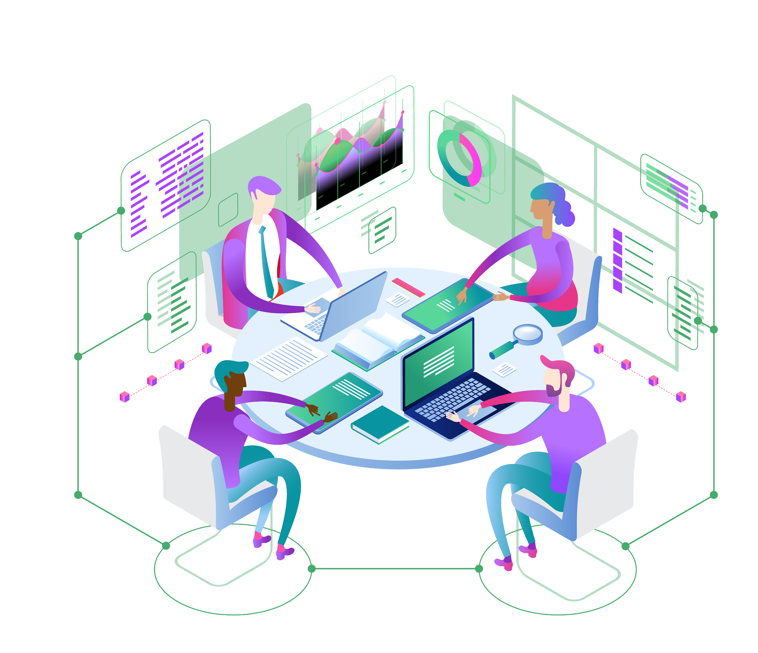
Notes:
Introduce yourself and allow the Facilitator to introduce themselves.
Input real titles and perhaps contact info.

Slide 6


Slide 7

Notes:
Speak with the attendees about how they’ll learn through being taught concepts then participating in interactive activities using their device of choice (smartphone, tablet, or laptop) as individuals and using their wits, experiences and expertise within groups alongside their peers.
Workshop is intended to give you information to operate as a FinOps practitioner. You should be able to pass the certification after the class.
This is intended to be for beginners through advanced cloud users, but requires a certain basic level of understanding. You should have gotten a pre-read
In the morning we will be talking mostly about the foundations of FinOps, what it is, why we do it, what it’s Principles are and how you build a FinOps team.
In the afternoon we will talk mostly about how to put FinOps in practice - working through the FinOps lifecycle.

Slide 8

Notes:
There are expected to be three levels of FinOps certification, this is just the first.

Slide 9
Cloud spending has reached a tipping point
The Rise of the Cloud Economy
Public Cloud Spend
$360B
by 2022
2000’s
2006
Now
Datacenter Centric IT
Fixed Cost
CapEx Weighted Spend
Born in the Web Companies
EC2 Launched, Rise of Agile & Devops
Cloud Centric IT
Variable Cost
OpEx Weighted Spend
Notes:
Spend 5 minutes on this. Foundational.
Key Messages:
Fixed costs changing to Variable Costs
2000s, Demand from customers using the Internet and Mobile created Business Demand for speed
that led to DevOps
DevOps - allowed IT to manage at the speed of the business with RAPID, INCREMENTAL DEVELOPMENT CYCLES
Lean and Agile helped optimize DevOps
Cloud spending now becoming substantial, tipping point for future development
~$60B in 2019, SIX TIMES THAT in 3 years
Next: Let’s take a look at what’s changed in the way IT is procured.

Slide 10
Through 2020, 80% of organizations will initially overshoot their IaaS budget, due to a lack of cloud cost optimization governance and misguided upfront cloud spend commitments.
Notes:
What this leads to is an opportunity to overrun budgets in a significant way
Gartner stat
Other points:
35% of cloud costs will be wasted in 2020 (Rightscale state of the cloud by Flexera)
29% of IT professionals surveyed by IDG in late 2018 said spend was #1 concern. This was across all job categories

Slide 11




Icon Slide
Decentralized
Material
Variable
Inefficiency
Buying centers for cloud are siloed from Finance and Central IT
24% year over year increase in public cloud spend
Variable/consumption based cloud spend replacing data center/fixed cost spend
Macroeconomic instability pressuring cloud spend and usage towards efficiency

Slide 12
FinOps brings financial accountability to variable cloud spend with:
A prescriptive model of actions, best practices and culture
That enables distributed product, finance, and business teams
To make decisions that increase business value

Slide 13
FinOps Lifecycle Action Loop
Inform
Visibility & Allocation
Optimize
Utilization & Rate
Opportunities
Operate
Continuous Improvement & Operations

Slide 14




FinOps Lifecycle Maturity
Crawl, Walk, Run
Notes:
GO Through Quickly, we’ll cover more later.
The FinOps Lifecycle shares a common point of view on activity with Agile or other continuous improvement methodologies.
Crawl, Walk, Run
Just as in Agile, you start with an MVP, and build capabilities as you learn more, exercise the lifecycle of development and improve.
So it is with FinOps
Start at a crawl - do not try to boil the ocean or achieve 100% RI coverage all at once
There is no value judgment here!!! Every organization is not at the same level. Every organization does not need to be at the same level
Each capability can be at a different level of maturity as well - not everyone needs to have a super advanced chargeback structure, or a highly-optimized RI portfolio management strategy.
Mature the capabilities that provide your company strategic value

Slide 15
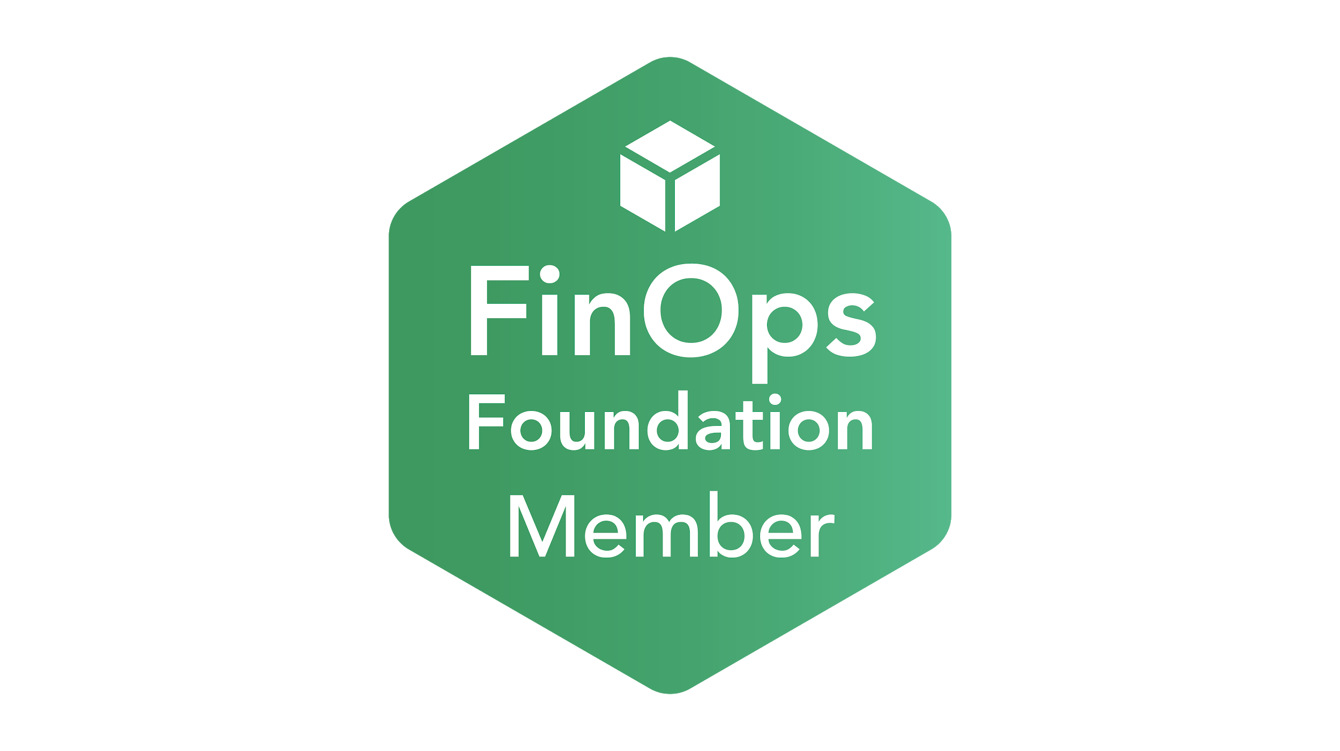
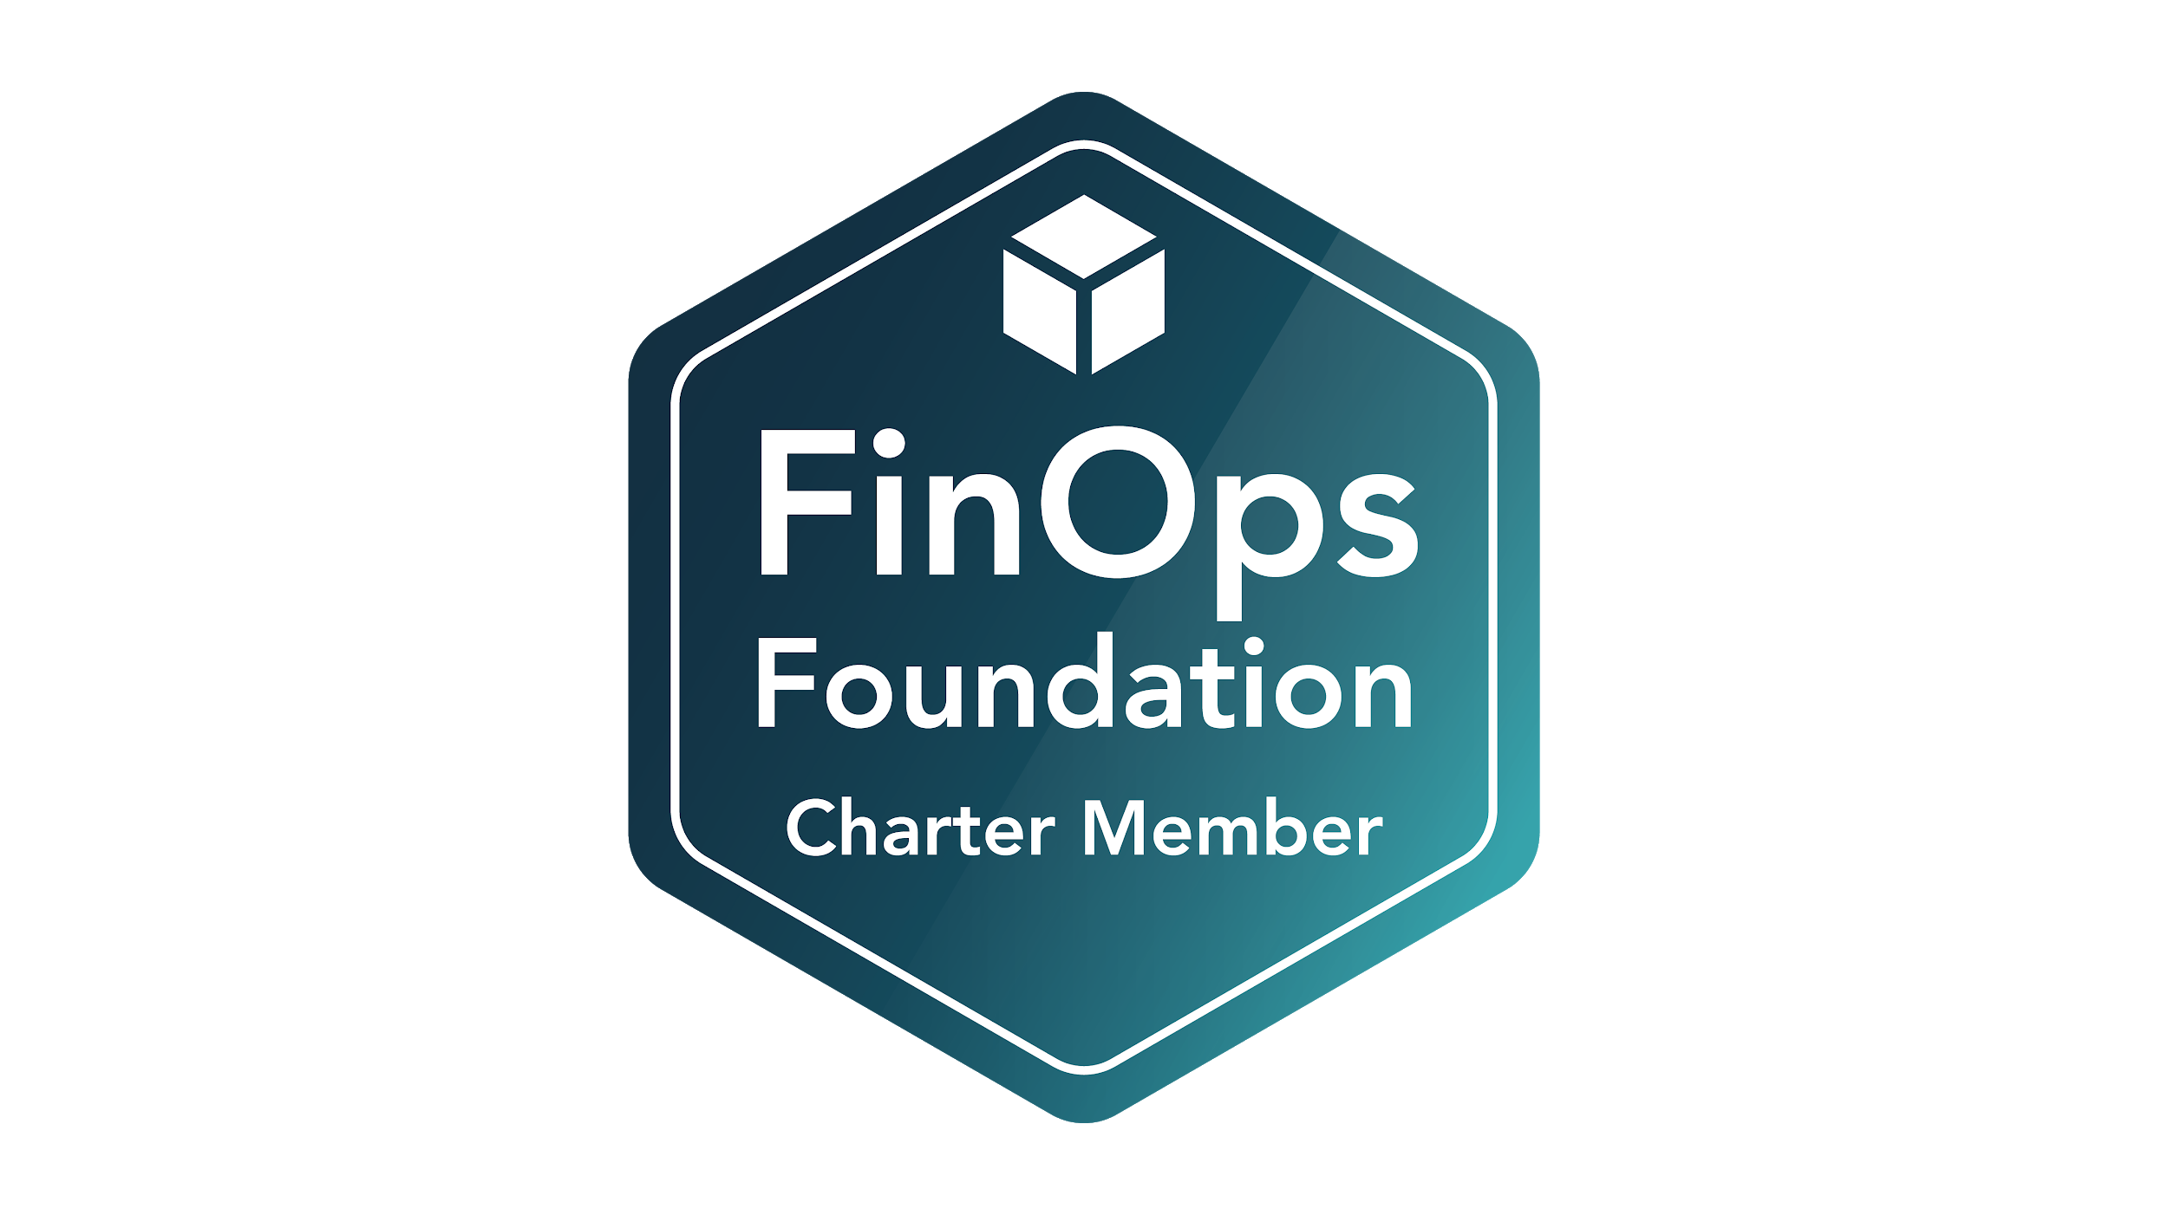
How Do Others FinOps?
The FinOps Foundation offers:
A Community of FinOps Practitioners
Shared Slack Channels for discussions
Biweekly meetings with topics of common interest
Snazzy badges
finops.org
Notes:
If you are interested in continuing the journey and helping/getting help from others.
Join the FinOps foundation at finops.org

Slide 16
FinOps Certification
Certification levels anticipated for:
FinOps Practitioner
FinOps Associate
FinOps Professional

Slide 17
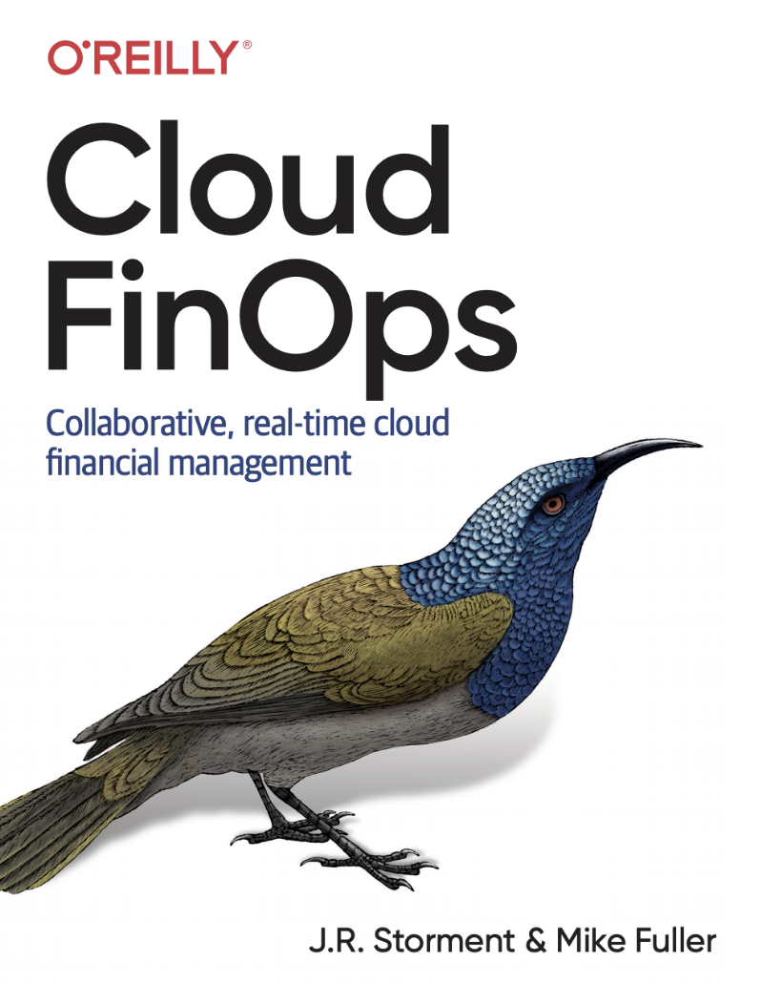
Now Available! by O’Reilly Media
Collaboratively contributed by FinOps Foundation members
Available on Amazon

Slide 18
Final Questions

Slide 19
Thank you Sponsors

